Slide 1


Regioselective Fluorohydrin Synthesis from Allylsilanes and Evidence for a Silicon-Fluorine Gauche Effect
Thesis Defense
Alexie Clover
5/24/2023
1

Slide 2
Thesis Design
This thesis will focus on further developing both silicon-tethered reactions discovered in the O’Neil lab with an eye toward generating useful intermediates that can be used to synthesize biologically active small molecules.
  1. Starting from the iodine mediated rearrangement product one can synthesize increasingly complex structures that contain more reactive sites.
O’Neil, G. W.; Cummins, E. J. Iodine-Mediated Rearrangements of Diallylsilanes. Tetrahedron Lett. 2017, 58 (35), 3406–3409.
2

Slide 3
Thesis Design
This thesis will focus on further developing both silicon-tethered reactions discovered in the O’Neil lab with an eye toward generating useful intermediates that can be used to synthesize biologically active small molecules.
  1. Starting from the iodine-mediated rearrangement product one can synthesize increasingly complex structures that contain more reactive sites.
  2. One aim is to expand the diallylsilane rearrangements to include elements other than iodine. In particular, the development of an epoxide-promoted rearrangement is of significant interest due to the value of further modification.
3

Slide 4
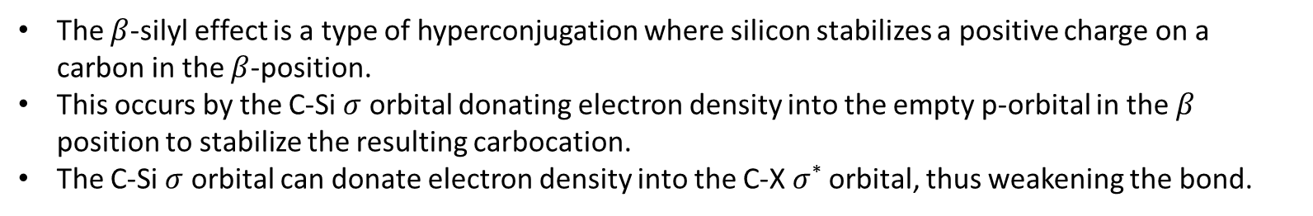
The Beta-Silicon Effect
The $β$-silyl effect is a type of hyperconjugation where silicon stabilizes a positive charge on a carbon in the $β$-position.
This occurs by the C-Si $σ$ orbital donating electron density into the empty p-orbital in the $β$ position to stabilize the resulting carbocation.
The C-Si $σ$ orbital can donate electron density into the C-X $σ$* orbital, thus weakening the bond.
Silicon in Organic Synthesis Colvin, E. Butterworth: London 1981
4

Slide 5
The Beta-Silicon Effect
The $β$-silyl effect is a type of hyperconjugation where silicon stabilizes a positive charge on a carbon in the $β$-position.
This occurs by the C-Si $σ$ orbital donating electron density into the empty p-orbital in the $β$ position to stabilize the resulting carbocation.
The C-Si $σ$ orbital can donate electron density into the C-X $σ$* orbital, thus weakening the bond.
Silicon in Organic Synthesis Colvin, E. Butterworth: London 1981
5

Slide 6
Oxygen-Mediated Diallyl Silane Rearrangements
Previously:
Cummins and O’Neil, Tet. Lett. 2017, 58, 3406
Proposed intramolecular epoxide allylation:
7
9

Slide 7
Rearrangement with the epoxide using Acids
With this proposed rearrangement in mind we decided to start screening.
via
10
26
Notes:
Now with the access to the epoxides, we set out to screen different acids that might promote the rearrangement.

Slide 8
Rearrangement with the epoxide
11
27

Slide 9
Rearrangement with the epoxide
81.5%
12
28

Slide 10
Attempts at an Intramolecular Epoxide Allylation
Entry | Lewis Acid | Solvent | Temp. (℃) | Time (hr) | Conv. %
1 | TiCl₄ | DCM | -78 | 1 | 44
2 | TiCl₄ | DCM | -78 | 2 | 82^{b}
3 | TiCl₄ | MeCN | -20 | 2 | 100
4 | (Et)₂AlCl | DCM | -78 | 1 | 100
5 | (Et)₂AlCl | DCM | 25 | 0.5 | 100
6 | (Et)₂AlCl | DCM | 25 | 1 | 100
7 | Me₃SiCl | DCM | -78 | 1 | ~50
8 | Me₃SiCl | DCM | 25 | 1 | 100
ªConv % based on the amount of starting material reacted.
29

Slide 11
Attempts at an Intramolecular Epoxide Allylation
Entry | Lewis Acid | Solvent | Temp. (℃) | Time (hr) | Conv. %
1 | BF₃•Et₂O | DCM | 0 | 1 | 100
2 | BF₃•Et₂O | DCM | -78 | 1 | 100
3 | BF₃•Et₂O | DCM | -78 | 2 | 100
4 | Ti(O-iPr)₄ | DCM | 0 | 1 | 0
5 | Ti(O-iPr)₄ | DCM | 25 | 16 | 0
6 | Ti(O-iPr)₄ | PhMe | 60 | 4 | 0
7 | Ti(O-iPr)₄ | HFIP | 25 | 4 | 100
8 | TBDMS Triflate | DCM | 25 | 16 | 100
9 | Sn(OTf)₂ | DCM | 25 | 16 | 100
10 | Sc(OTf)₃ | DCM | 25 | 16 | 100
11 | Bi(OTf)₃ | DCM | 25 | 16 | 100
12 | BiBr₃ | DCM | 25 | 16 | 100
ªConv % based on the amount of starting material reacted.
30

Slide 12
Use of a Brønsted Acid
this signal?
15
33

Slide 13
Use of a Brønsted Acid
this signal?
16
34

Slide 14
Why Fluorine
A strive for the addition of fluorine to organic molecules has risen and is in more than 30 % of the 100 best-selling small molecule drugs.
Fluorine has some unique properties including increasing the lipophilicity and potency of the drug.
Similar in size to hydrogen but more polar.
Positron-emission-tomography (PET) scans. Labeled fluorine-18 can be used to track the physiology of drugs. Important due to nuclear decay properties of fluorine. The half-life is “just right”.
As of August 2021, there are 16 FDA-approved PET tracers, in which 10 of them contain fluorine.
McGrath, N. A.; Brichacek, M.; Njardarson, J. T. J. Chem. Educ. 2010, 87, 1348.
Gillis, E. P.; Eastman, K. J.; Hill, M. D.; Donnelly, D. J.; Meanwell, N. A. J. Med. Chem. 2015, 58, 8315.
7

Slide 15
Initial Discovery of Fluorohydrin
HF•Pyr led to a more complex mixture.
HF•TEA was rather clean, with little to no side products.
The formation of the fluorohydrin took place in mild conditions being that it proceeded at room temperature with five equivalents of HF•TEA.
This was appealing because the reagent HF•TEA is a milder version, being significantly less acidic and therefore easier to handle.
35

Slide 16
Synthesis of Fluorohydrins from Epoxides
Usually the conditions need to open epoxides with HF·TEA require long run times with high temperatures.
Chen, J.-L.; Zheng, F.; Huang, Y.; Qing, F.-L., J. Org. Chem. 2011, 76 (16), 6525–6533.
Al-Maharik, N.; Kirsch, P.; Slawin, A. M. Z.; O’Hagan, D., Tetrahedron 2014, 70 (31), 4626–4630.
37

Slide 17
Synthesis of Fluorohydrins from Epoxides
Another case of high temperatures with long run times.
Brunet, V. A.; Slawin, A. M. Z.; O’Hagan, D. Three Step Synthesis of Single Diastereoisomers of the Vicinal Trifluoro Motif. Beilstein J. Org. Chem. 2009, 5, 61.
38

Slide 18
Epoxidation of Allylsilanes
Exploring other allylsilanes that could be converted to the fluorohydrin.
ª Reagents and conditions: TBAHS (0.04 eq.), K₂CO₃ (0.1 M aq., 0.2 eq.), CH₃CN:DMM (2:1) (0.125 M), oxone (3 eq. in 0.125M 4 x 10⁻⁴ M EDTA), K₂CO₃ (13.3 eq. in 0.125 M H2O). ^{b} mCPBA (1.2 eq.), DCM (0.067 M)
39

Slide 19
Fluorohydrin Synthesis from Epoxides
Transforming epoxysilanes into fluorohydrins under mild conditions.
Minor impurities include the diol and a Meinwald-type rearrangement.
Regioselectivity.
The isolated yield is given in paratheses, followed by the overall yield from allylsilanes. ª HF•TEA (10 eq.), DCM (0.1 M).
40

Slide 20
Fluorohydrin Synthesis from Epoxides
Transforming epoxysilanes into fluorohydrins under mild conditions.
Minor impurities include the diol and a Meinwald-type rearrangement.
Regioselectivity.
The isolated yield is given in paratheses, followed by the overall yield from allylsilanes. ª HF•TEA (10 eq.), DCM (0.1 M).
Entry | Solvent | Conv. % to final prod.
1 | DCM | 50
2 | MeCN | 18
3 | THF | 0
41

Slide 21
Fluorohydrin Synthesis from Epoxides
Transforming epoxysilanes into fluorohydrins under mild conditions.
Minor impurities include the diol and a Meinwald-type rearrangement.
Regioselectivity.
The isolated yield is given in paratheses, followed by the overall yield from allylsilanes. ª HF•TEA (10 eq.), DCM (0.1 M).
Entry | Solvent | Conv. % to final prod.
1 | DCM | 50
2 | MeCN | 18
3 | THF | 0
42

Slide 22
One-pot Synthesis of Fluorohydrins
To our satisfaction, the TMS fluorohydrin was isolated along with the allyldimethylsilyl fluorohydrin and allyldiphenylsilyl fluorohydrin in higher yield.
Formation of hydroxy ester (minor impurity).
44

Slide 23
Substituted Allylsilanes
Attempts at an alpha, beta, gamma substituted allylsilane (ex: 1-3)
Attempting a more “charged” allylsilane (ex: 4)
1)
2)
3)
4)
(More info on the next slide)
44

Slide 24
Substituted Allylsilanes
We hoped using a less sensitive allylsilane would allow us to make this transformation
54

Slide 25
Probing the Mechanism
To determine if the mechanism of this transformation was more S_{N}1 or S_{N}2 like, three different enantioenriched epoxides were prepared.
Using the measured optical activity for triisopropyl silyl epoxide, a comparison was made with what was reported previously in literature.
45

Slide 26
Probing the Mechanism
Subjecting the enantioenriched epoxides to HF then followed by esterification from the chiral carboxylic acid.
The epoxide ee and fluoroester d.r. were similar, suggesting S_{N}2.
46

Slide 27
Probing the Mechanism
Complete retention of ee from the i-Pr₃. However, an erosion of ee was observed for the other two epoxysilanes.
Suggests S_{N}2 type mechanism.
R | Epoxide ee^{A} | Fluorohydrin ee^{B}
i-Pr₃ | 60 | 60
Me₂Ph | 64 | 38
Ph₃ | 59 | 43
Notes: ^{A}ee from d.r. of bromomandelation.
^{B}ee from d.r. of mosher esterification.
46

Slide 28
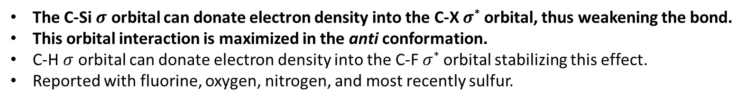
The Beta-Silicon Effect
The C-Si $σ$ orbital can donate electron density into the C-X $σ$* orbital, thus weakening the bond.
This orbital interaction is maximized in the anti conformation.
C-H $σ$ orbital can donate electron density into the C-F $σ$* orbital stabilizing this effect.
Reported with fluorine, oxygen, nitrogen, and most recently sulfur.
Silicon in Organic Synthesis Colvin, E. Butterworth: London 1981
61

Slide 29
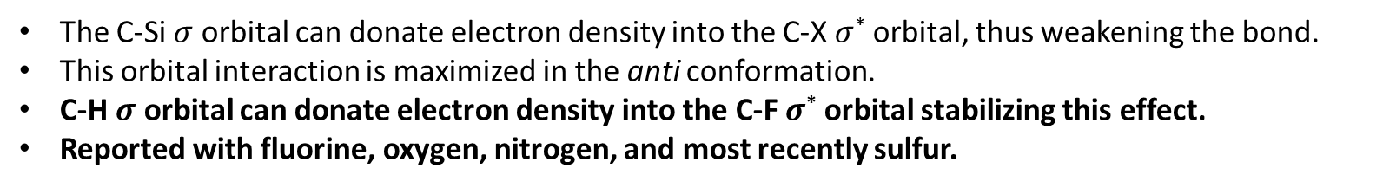
The Beta-Silicon Effect / Fluorine gauche Effect
The C-Si $σ$ orbital can donate electron density into the C-X $σ$* orbital, thus weakening the bond.
This orbital interaction is maximized in the anti conformation.
C-H $σ$ orbital can donate electron density into the C-F $σ$* orbital stabilizing this effect.
Reported with fluorine, oxygen, nitrogen, and most recently sulfur.
Silicon in Organic Synthesis Colvin, E. Butterworth: London 1981
62

Slide 30
NMR study
Hyperconjugation considerations would suggest a preferred anti-periplanar C-Si and C-F arrangement, with stabilization afforded by the overlap between the high energy σ C-Si and the low energy σ* C-F.
Interestingly, ¹H NMR analysis provides evidence that the observed conformation is gauche.
Both fluorohydrins display one large (33-35 Hz) and one small (13.5-13.6 Hz) ³J_{HF} coupling constant.
R | J_{F-Ha} (Hz) | J_{F-Hb} (Hz)
Me | 32.6 | 13.6
Ph | 35.3 | 13.5
Alabugin, I. V.; Gomes, dos Passos Gomes, G.; Abdo, M. A. "Hyperconjugation" WIREs Comput. Mol. Sci. 2019, 9, e1389
Dolbier, W. R. Guide to Fluorine NMR for Organic Chemists. Chapter 2; John Wiley & Sons, Inc.: Hoboken, NJ, USA, 2009.
66

Slide 31
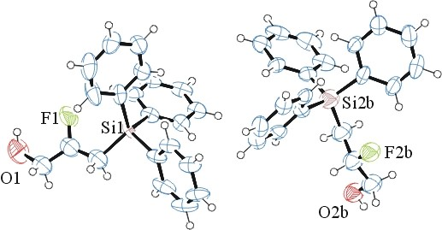
Crystal Structure of Triphenylsilyl Fluorohydrin
Two independent structures were observed having different orientations.
Crystal structure shows gauche conformation for both species identified in the unit cell.
The electron-poor silicon could prove to be electrostatically attractive toward the electronegative fluorine. This would also result in a smaller dipole moment further stabilizing this conformation.
Note the F-OH orientation (Ø_{F-OH} = 18°, 179°)
The dihedral angle between silicon and fluorine was observed to be 6º in the left crystal structure and 38º in the right.
65
Notes:
The dihedral angle between silicon and fluorine was observed to be 6º in the left crystal structure and 38º in the right. The ORTEP image of one shows the fluorine and alcohol gauche to one another with a dihedral angle of 18º (as shown in Figure 4.5 on the left), whereas in the other we observe the anti configuration (179º) for the fluorine and alcohol groups (right, structure).

Slide 32
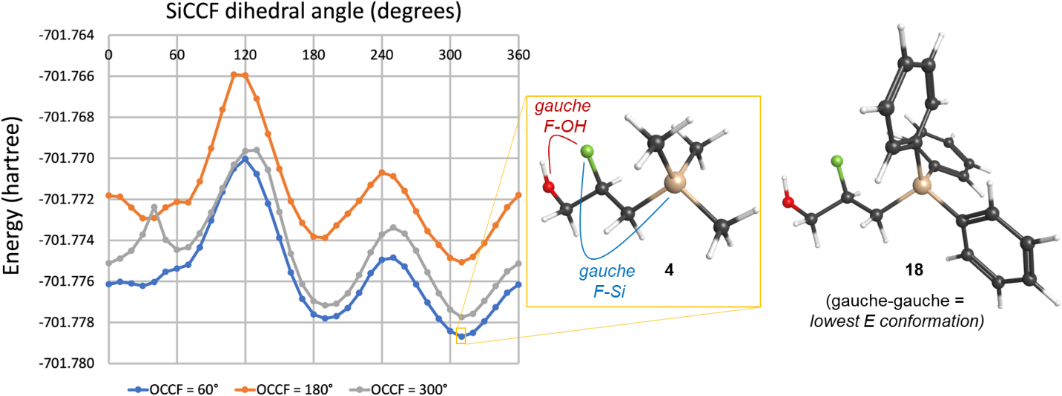
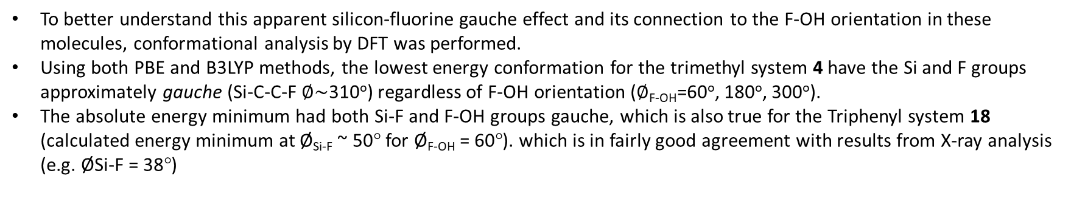
Computational study of TMS Fluorohydrin
To better understand this apparent silicon-fluorine gauche effect and its connection to the F-OH orientation in these molecules, conformational analysis by DFT was performed.
Using both PBE and B3LYP methods, the lowest energy conformation for the trimethyl system 4 have the Si and F groups approximately gauche (Si-C-C-F $∅\sim$310º) regardless of F-OH orientation ($∅$_{F-OH}=60º, 180º, 300º).
The absolute energy minimum had both Si-F and F-OH groups gauche, which is also true for the Triphenyl system 18 (calculated energy minimum at Ø_{Si-F} ~ 50° for Ø_{F-OH} = 60°). which is in fairly good agreement with results from X-ray analysis (e.g. ØSi-F = 38°)
Results from DFT-PBE conformational analysis of 2-fluoro-3-(trimethylsilyl)propan1-ol (4). For three different F-OH orientations (Ø_{F-OH} = 60°, 180°, or 300°), the lowest energy conformer contained a gauche Si-F arrangement (Ø_{Si-F} ~ 310°).
63

Slide 33
Tamao Oxidation
The Tamao oxidation converts a carbon-silicon bond to a carbon-oxygen bond.
This is typically done through the activation of silicon using a fluorine source.
Once activated, it can be oxidized using peroxy acids or hydrogen peroxide.
55

Slide 34
Transformations and Tamao Oxidation
While silicon is an important element to many functional materials, its conversion to a hydroxy group via a Tamao-Fleming oxidation would lead to a more versatile alcohol functional group.
Entry | Conditions | Time
1 | R₃ = Ph₃ : TBAF, DCM, Δ | 3 hr
2 | R₃ = Ph₃ : BF₃-2AcOH, DCM, Δ | 5 hr
3 | R₃ = PhMe₂ : BF₃-2AcOH, DCM, rt | 5 min
Yamashita, Y.; Minami, K.; Kobayashi, S. Catalytic Addition Reactions of Alkylazaarenes to Vinylsilanes. Chem. Lett. 2018, 47 (5), 690–692. 45.
Matsumura, Y.; Suzuki, T.; Sakakura, A.; Ishihara, K. Catalytic Enantioselective Inverse Electron Demand Hetero-Diels-Alder Reaction with Allylsilanes. Angew. Chem. Int. Ed 2014, 53 (24), 6131–6134.
57

Slide 35
Transformations and Tamao Oxidation
Using a different allylsilane as a masked hydroxy group to oxidize silicon.
Entry | Conditions | Time
1 | BF₃-2AcOH, DCM | 30 min
2 | I₂, MeOH, DCM | 1 h
3 | I₂, CyOH, DCM | 1 h
Yamashita, Y.; Minami, K.; Kobayashi, S. Catalytic Addition Reactions of Alkylazaarenes to Vinylsilanes. Chem. Lett. 2018, 47 (5), 690–692. 45.
Matsumura, Y.; Suzuki, T.; Sakakura, A.; Ishihara, K. Catalytic Enantioselective Inverse Electron Demand Hetero-Diels-Alder Reaction with Allylsilanes. Angew. Chem. Int. Ed 2014, 53 (24), 6131–6134.
58

Slide 36
Success!!!
With our options for a Tamao oxidation becoming limited, we decided to try a one-pot procedure.
Thankfully this one-pot worked, although in low yield.
Triphenyl resulted in recovery of starting material.
Ibrahim, S. M. S.; Banerjee, K.; Slater, K. A.; Friestad, G. K. “A Tamao–Fleming Oxidation Route to Dipeptides Bearing N,O-Acetal Functionality” Tetrahedron Lett. 2017, 58, 4864– 4866.
59

Slide 37
Tamao Explanation
Possible explanation for the low yielding Tamao oxidation.
Anti conformation of pentavalent silicon could increase the likelihood of the elimination rxn we observed.
If electrostatics attraction (Si^{δ+} and F^{δ-}) is what controls the observed Si-F gauche effect in the neutral compound, upon activation of silicon to form the corresponding silicate (Si^{δ-}) during Tamao-Fleming oxidation, this attraction would then become a repulsion.
67

Slide 38
Conclusion
Scope
Tamao Oxidation
First report of a silicon-fluorine gauche effect
68

Slide 39
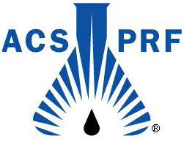
Acknowledgements
Advisor:
Dr. Gregory O’Neil
Group Members:
Adam Jones
Dr. Berger
Funding:
69

